Slide 1
Power BI Development Track
Graduation Project
Examination System

Slide 2
CONTENTS
1
ERD
2
Database Diagram
3
Stored Procedures
4
SSRS Reports
5
Dashboards
6
Documentation

Slide 3
ERD
&
Database Diagram

Slide 4
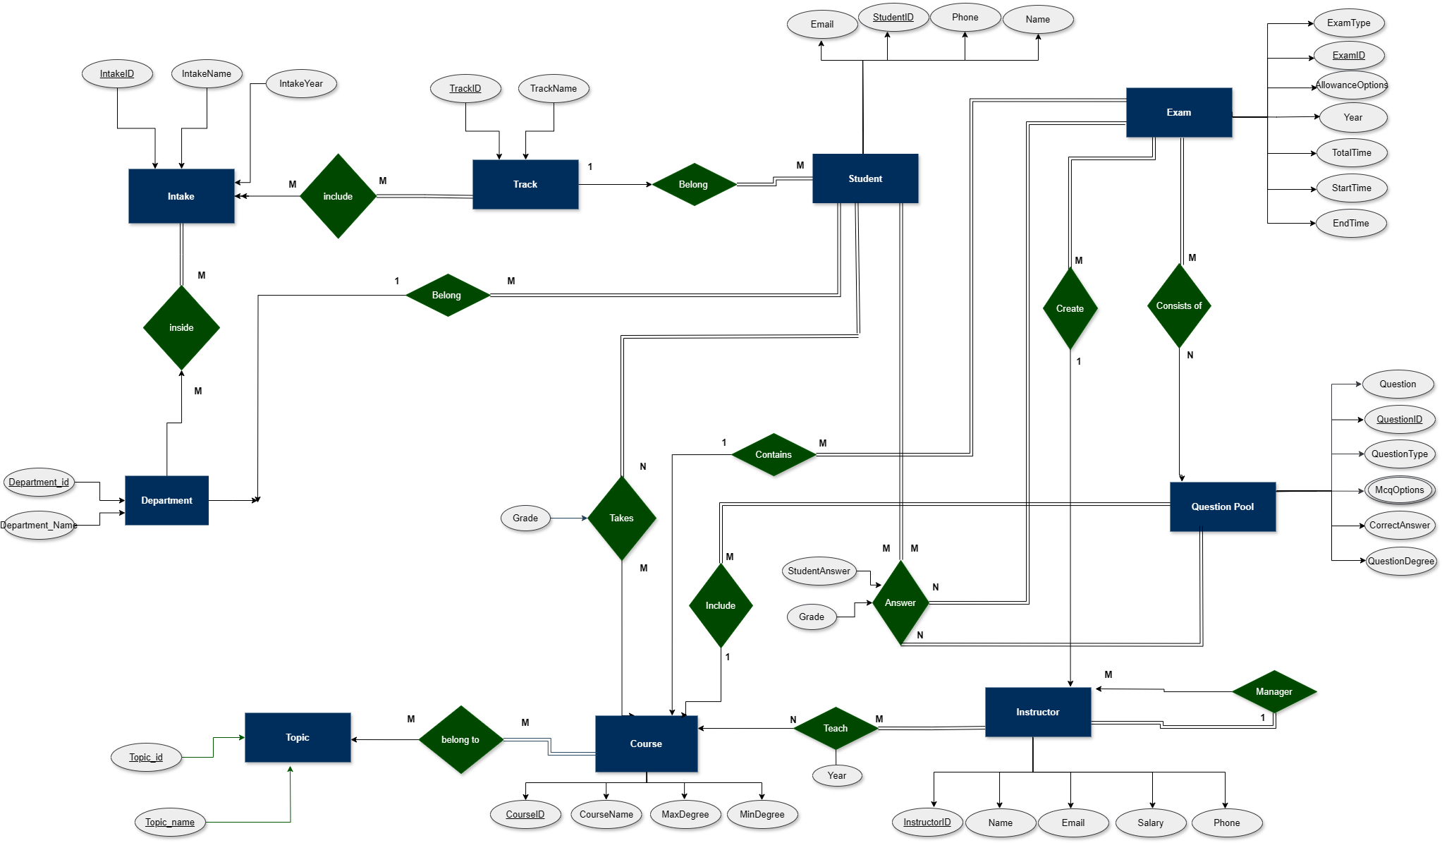
ERD

Slide 5
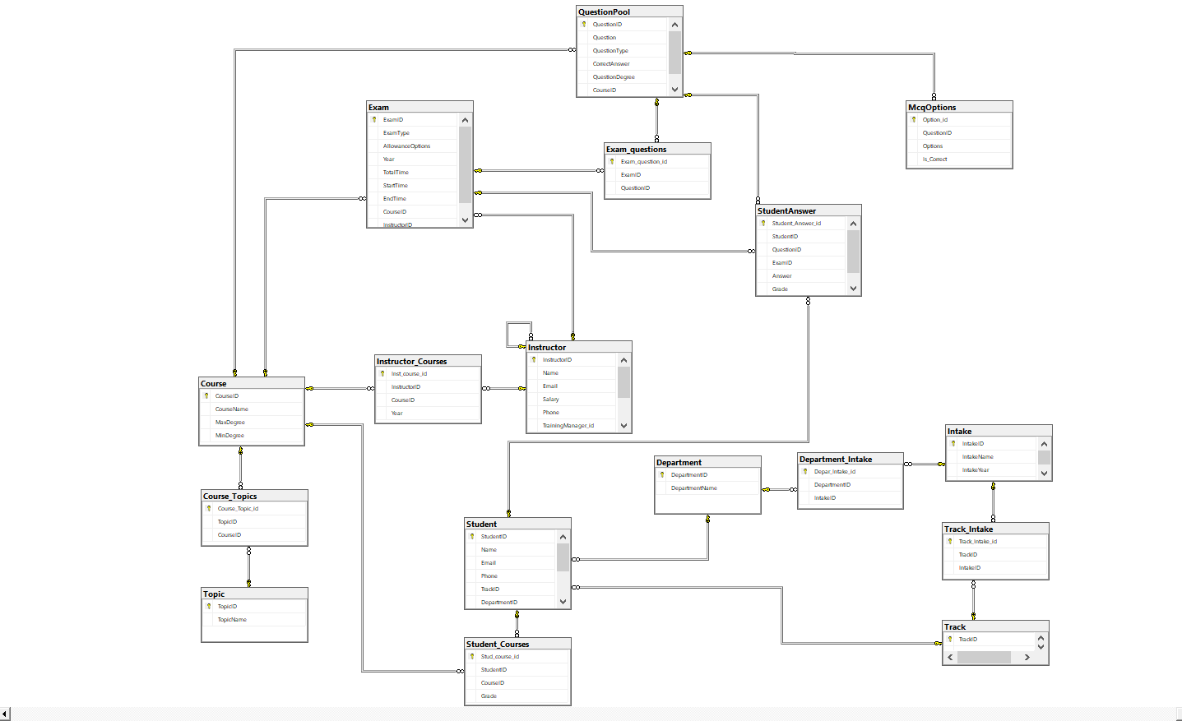
Database
Diagram

Slide 6
Reports

Slide 7
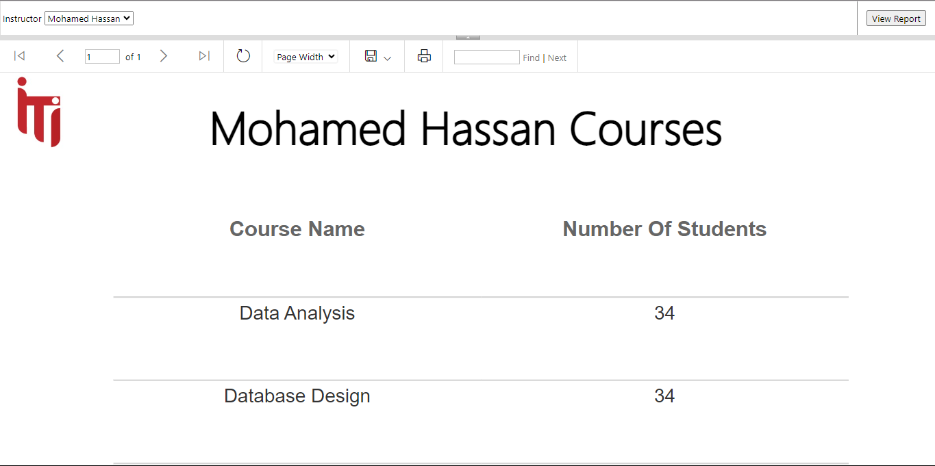
SSRS: Get Instructor Courses Report

Slide 8
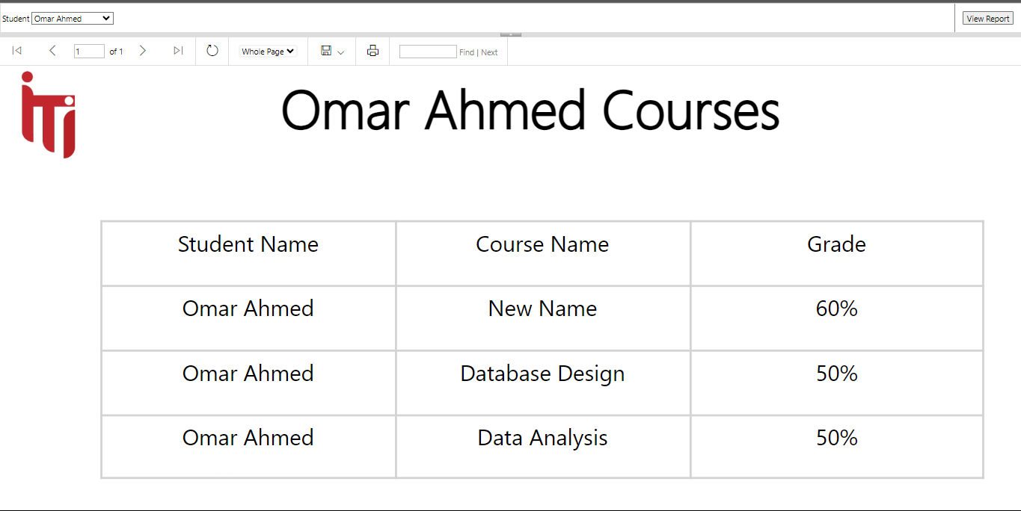
SSRS: Get Student Courses Report

Slide 9
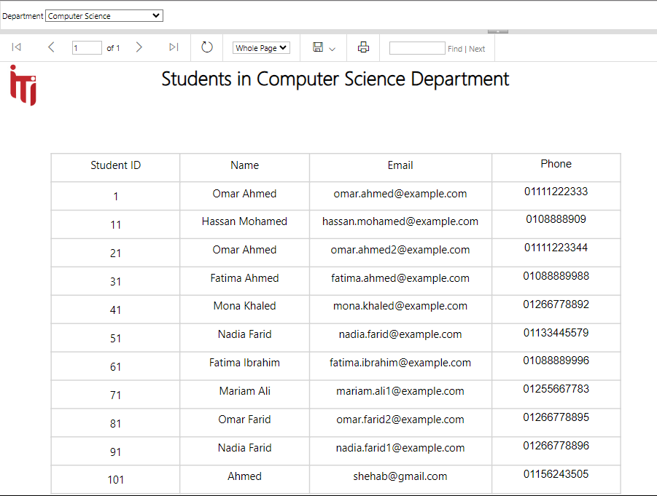
SSRS: Get Department Students Report

Slide 10
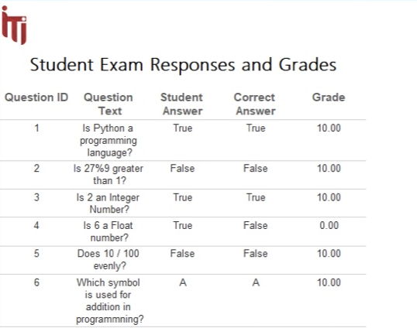
SSRS: Get Student Answers Report

Slide 11
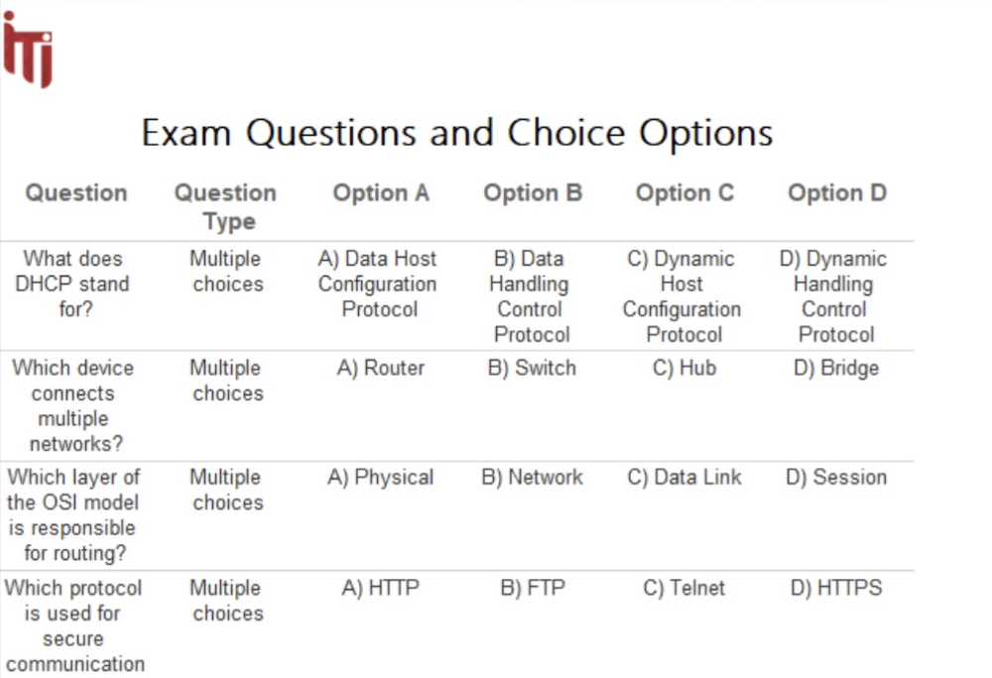
SSRS: Get Questions of each Exam Report

Slide 12
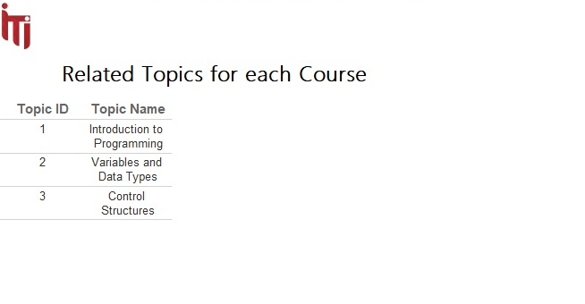
SSRS: Get Topics for Courses Report

Slide 13
Dashboards

Slide 14
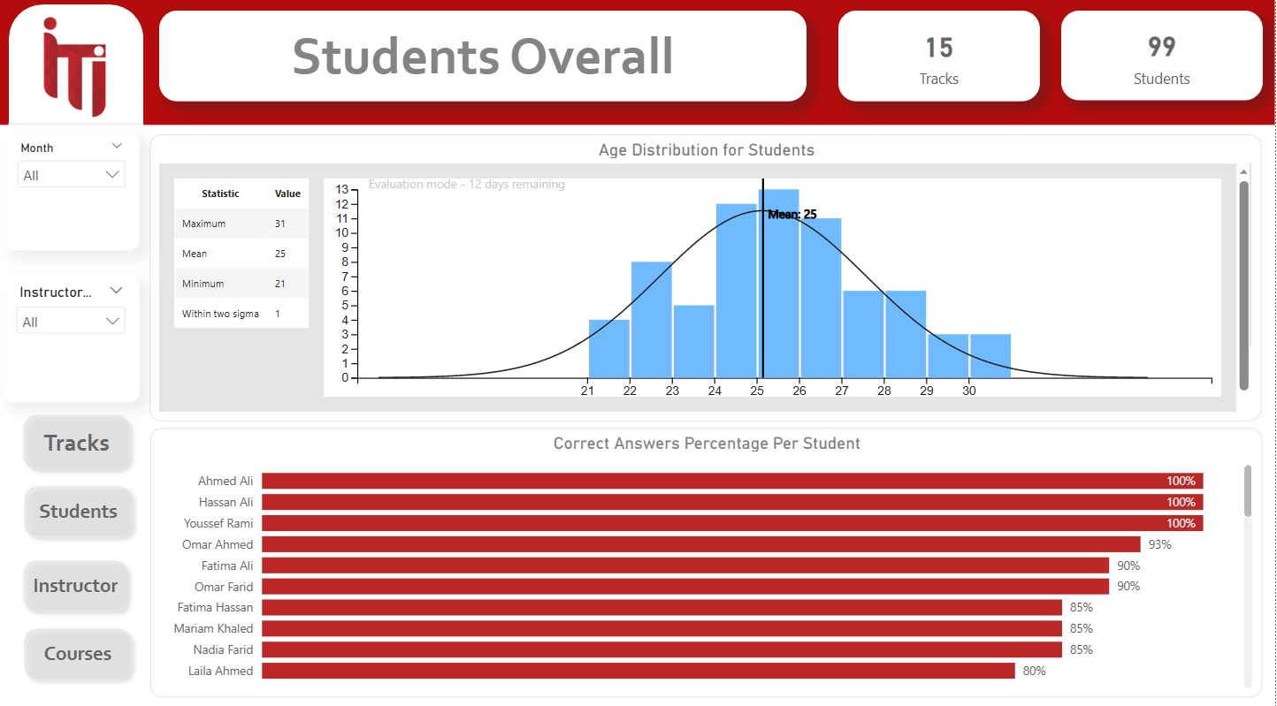
Students Overall Dashboard

Slide 15
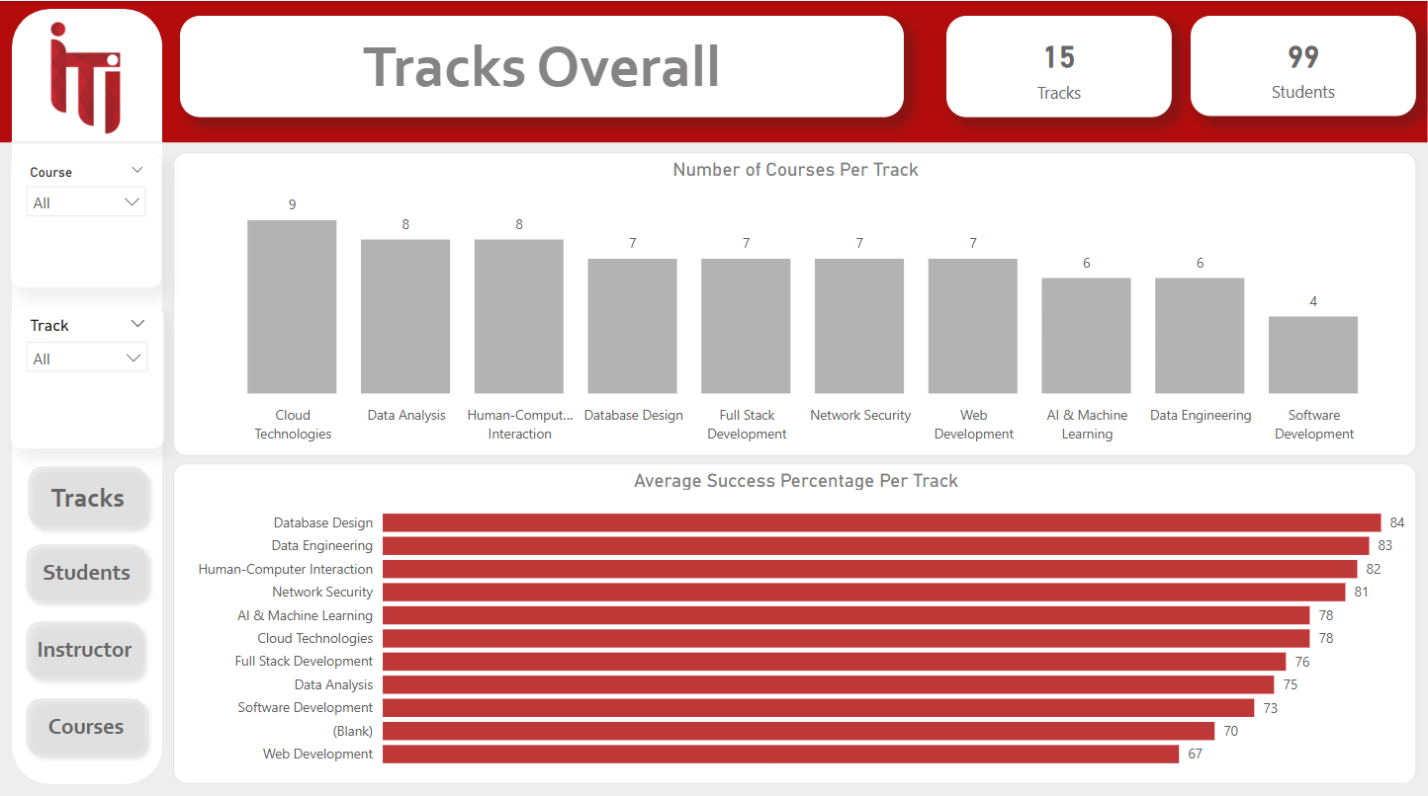
Tracks Overall Dashboard

Slide 16
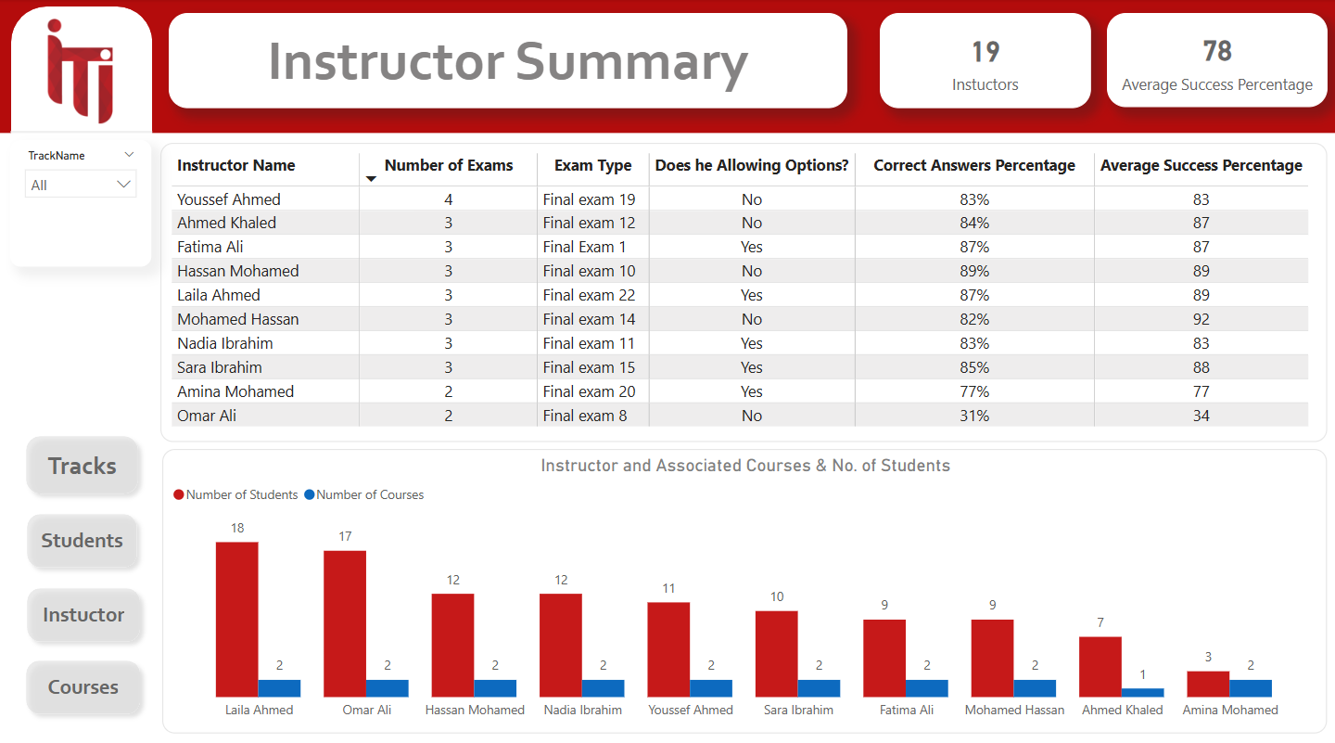
Instructors

Slide 17
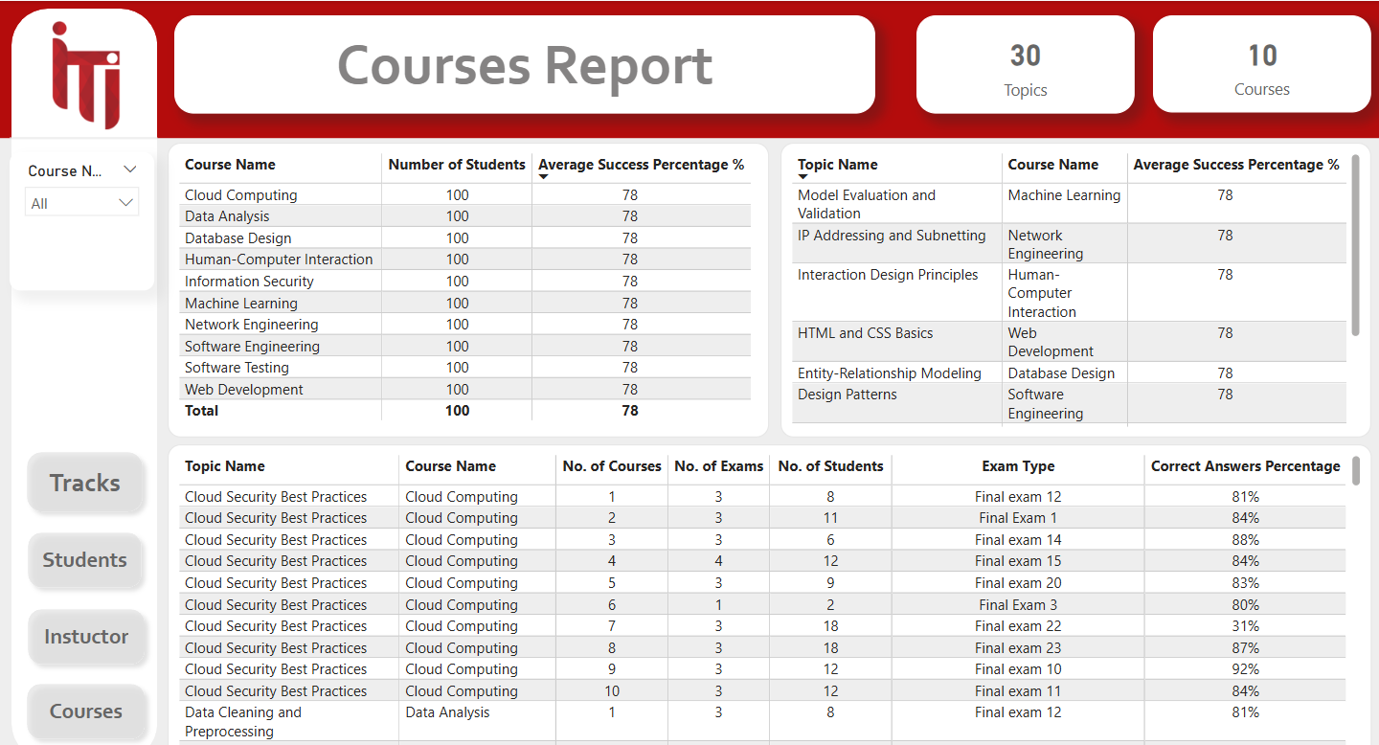
Courses Summary

Slide 18
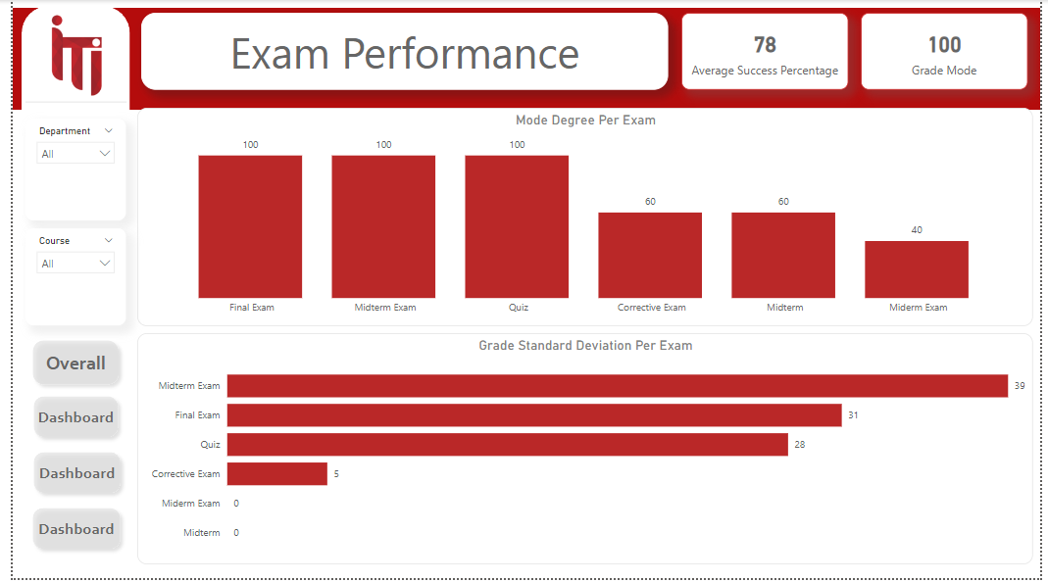
Exams Performance Dashboard

Slide 19
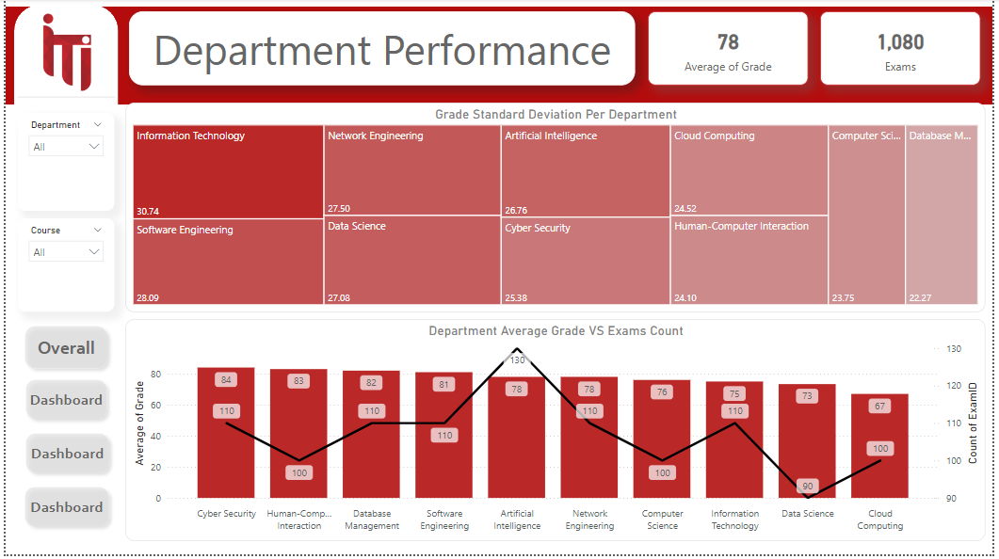
Department Performance Dashboard

Slide 20
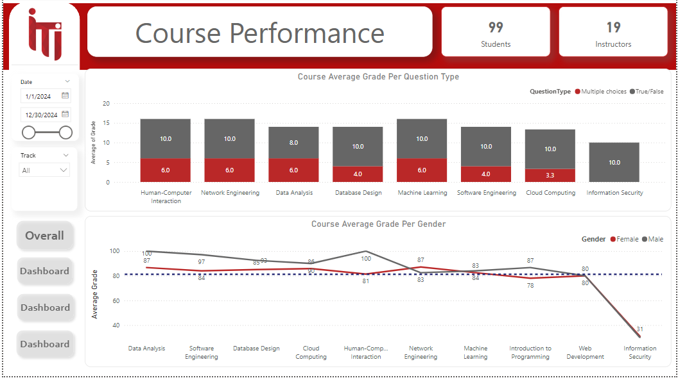
Course Performance Dashboard

Slide 21
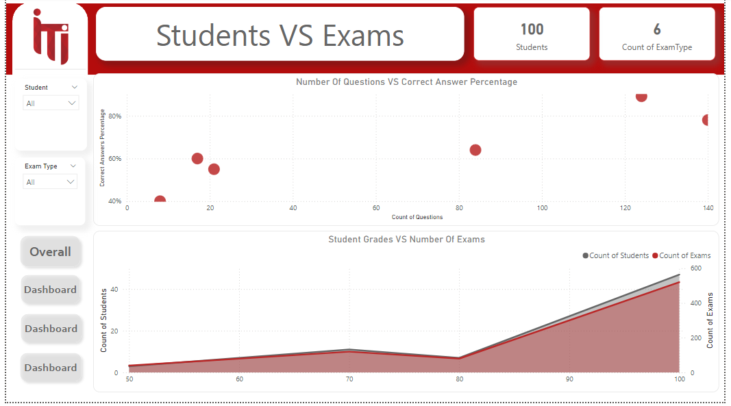
Studetns Performance Dashboard

Slide 22
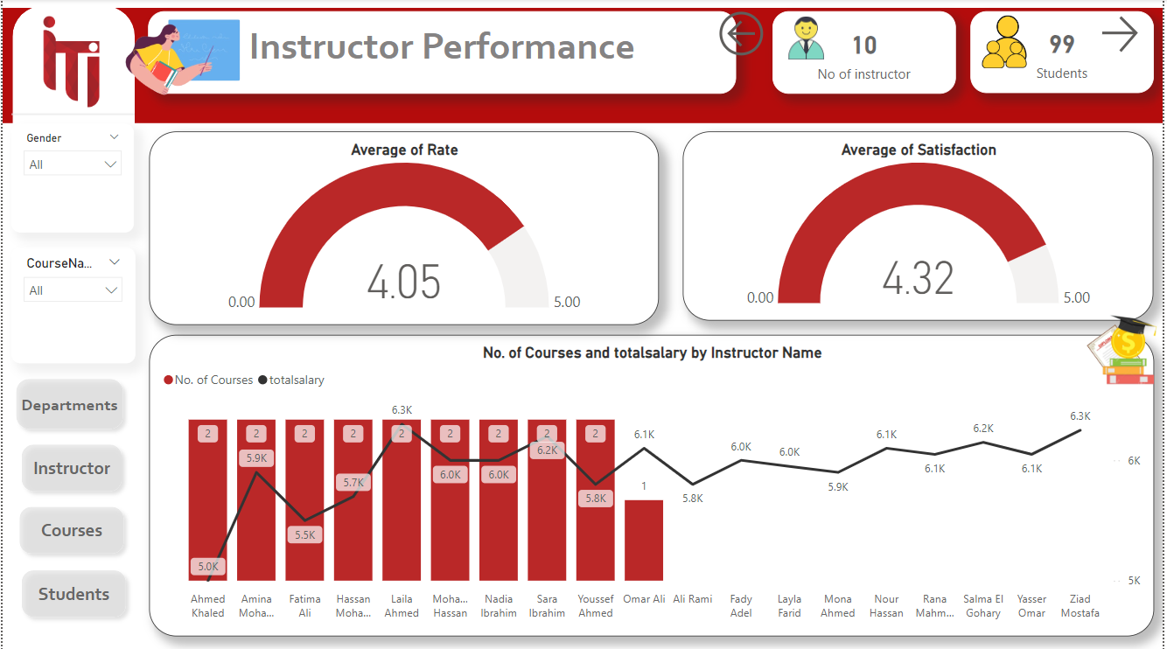

Slide 23
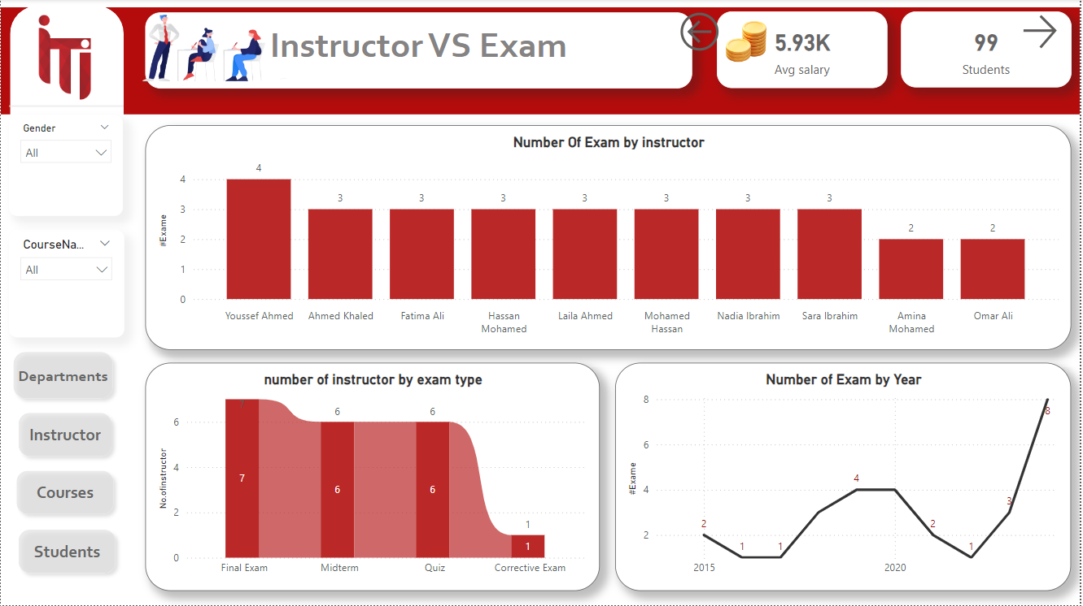

Slide 24
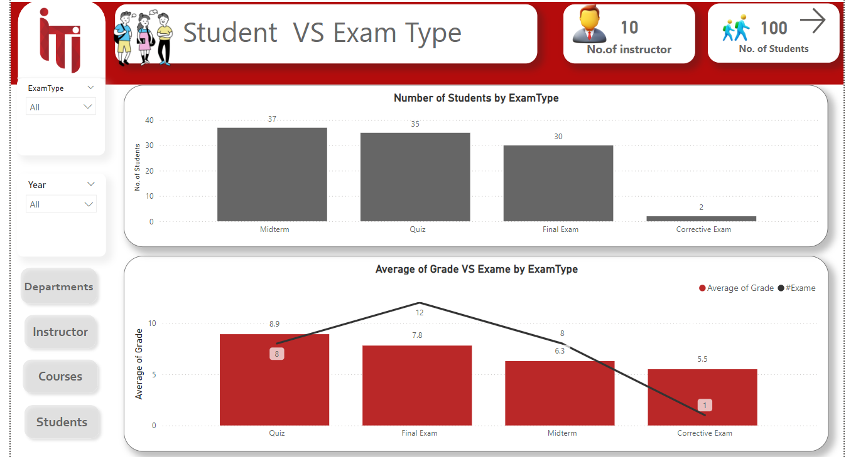

Slide 25
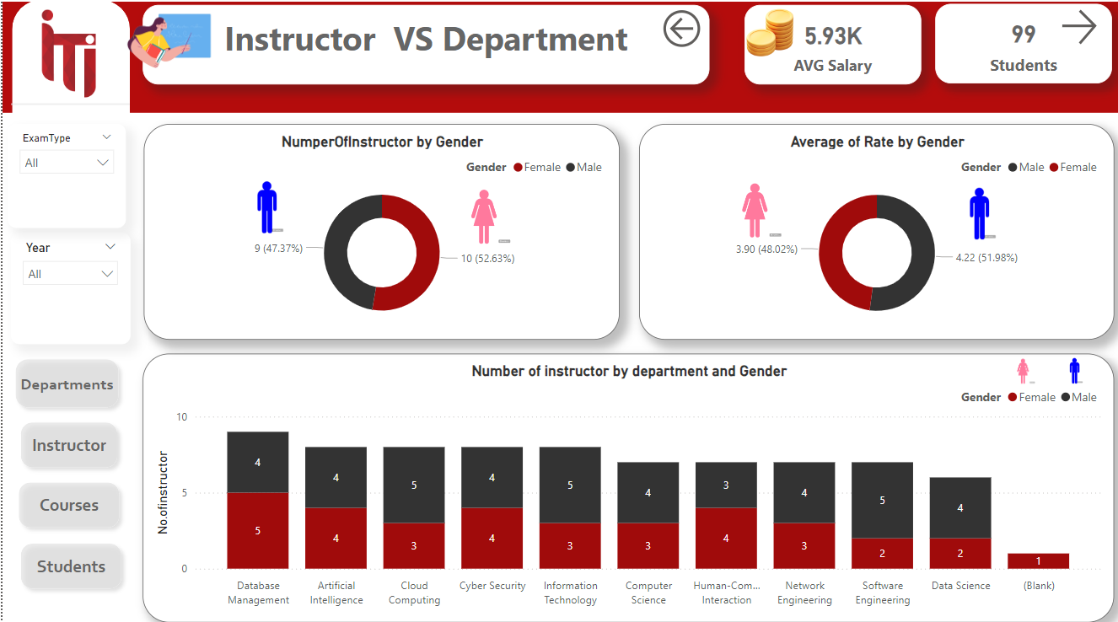

Slide 26
THANK YOU

